Slide 1
Diving Down the Ladder of Abstraction

Slide 2
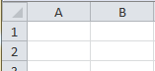



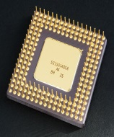
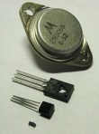


The Ladder of Abstraction
application software
high-level language
for thing in room:
pick_up(thing)
COBOL
C
low-level language
int register c;
Grace Hopper
en.wikipedia.org/wiki/File:Intel_80486DX2_bottom.jpg
010101010010101011111011010001010101011111111110
bytes and bits
N
P
N
-
+
+
-
http://en.wikipedia.org/wiki/File:Transistorer.jpg
voltage and current
-
-
-
+
-
physics
http://theloveforhistory.wordpress.com/2011/05/24/einstein
$$i\frac{h}{2π}\frac{∂}{∂t}\text{Y}=\hat{H}\text{Y}$$
Notes:
You might recall this slide from an earlier lesson. Abstractions build on each other and let people focus on one level of the ladder of abstraction at a time.
Note: the slide notes from Lesson 1.2 are shown here for easy reference for use in discussion.
At the bottom of it all is physics: Newton’s Laws and the four forces of the universe, and the two ways in which Newtonian physics had to be “fixed”: relativity and quantum mechanics.
We can ignore the physics and just pay attention to abstractions of the semiconductor, represented by a few equations that summarize current and voltage under certain conditions.
We can ignore the voltage and just trust that the CPU accepts 0s and 1s and steps through its instructions the way Intel designers say it does.
We can ignore the bits and just use a language like Hopper’s COBOL – nowadays, C or C++, or Java, letting those languages worry about the CPU.
We can even ignore the low-level languages and use a language like Scratch or Python, which take care of the lower level languages for us.
And we can deal with an even higher level of abstraction at the application level.
A funny comic: http://xkcd.com/435/

Slide 3

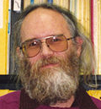
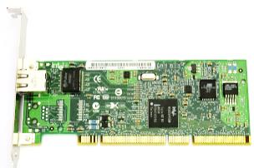

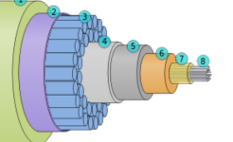
The Ladder of Abstraction
application software
page = urllib2.urlopen(“http://mysite.us”)
for line in page:
print line
high-level language
DNS, TCP/IP
The C Language
low-level language
if (ro==0) {
Jon Postel
Network Interface Card
bytes and bits
“On” is
4+ mW/m²
wavelength, intensity
physical layer
Light in glass fibers
Notes:
The examples pictured on that slide applied to one computer. When it comes to communication among computers, a similar ladder deals with increasingly abstract concepts. Scientists and engineers working at the lowest levels of abstractions can worry about the wires and cables and radio waves that carry the bits. The network interface card (NIC) takes care of how the bits get on and off the physical wire. The lower level protocols like TCP /IP are written in a low-level language, C. Higher level languages like Python have libraries that take care of high level protocols like HTTP for you. Application programmers use these abstractions to create software that uses interaction among computers, like a Web browser or a service like Google docs.
Note: The line of TCP/IP depicted is line 80 of ip_output.c
Note: Jon Postel, leader in Internet governance, RFC Editor, caretaker of the Internet through 1998 http://en.wikipedia.org/wiki/File:Jon_Postel_sitting_in_office.jpg

Slide 4
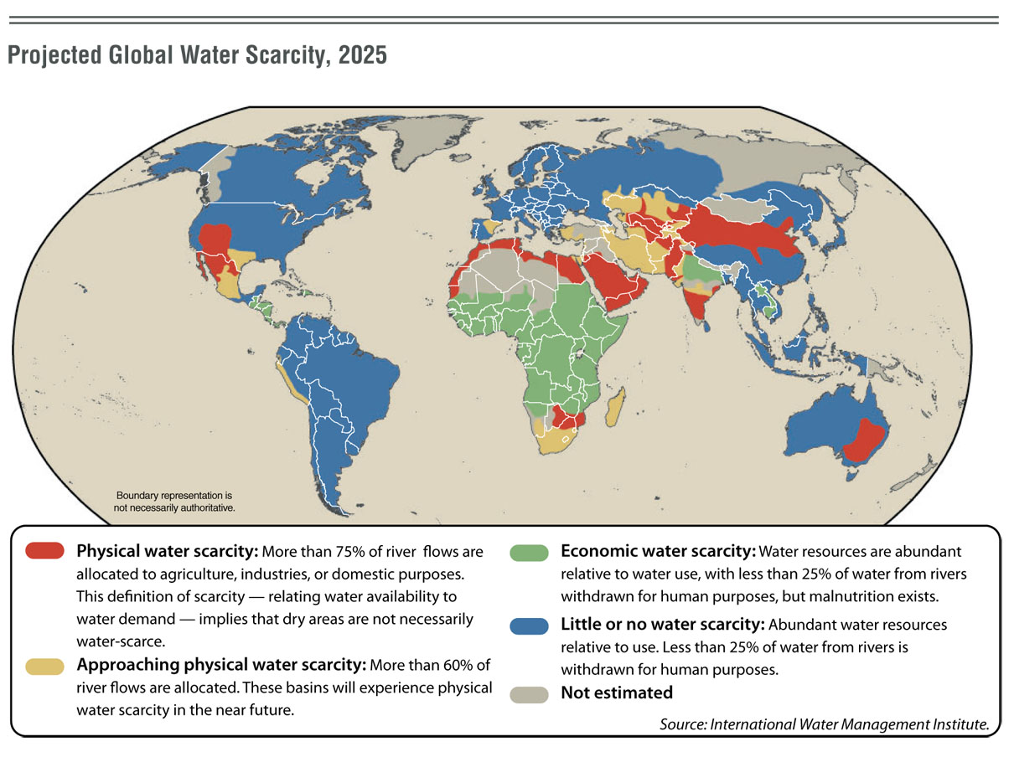
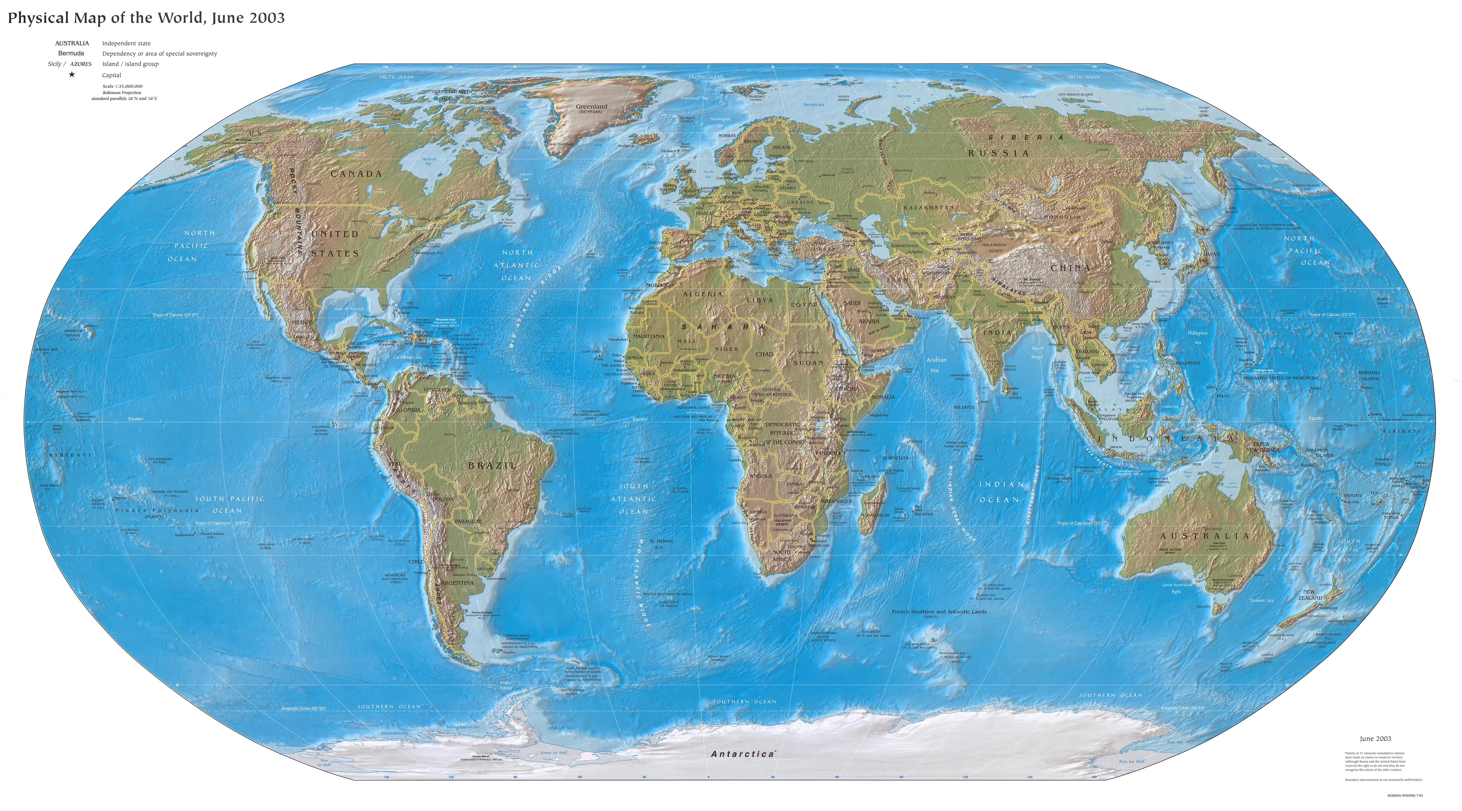
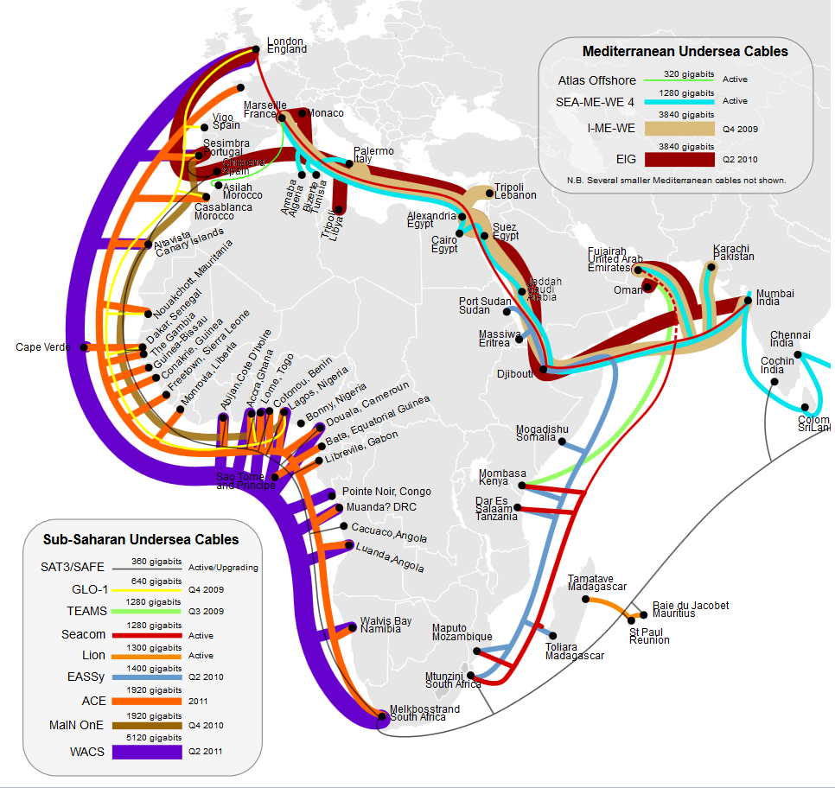
The Physical
World
Mediterranean Sea
West Africa
South Africa
Notes:
In this lesson we dive down the ladder of abstraction to the physical world of copper wires, glass fiber optics, and radio waves. Computing resources were initially concentrated in developed nations. Patterns among nations – the “Haves” and the “Have Laters” – continue to vary. People in different places have different access to information.
http://www.zonu.com/maps-l-en.htmlhttp://www.zonu.com/maps-l-en.html

Slide 5
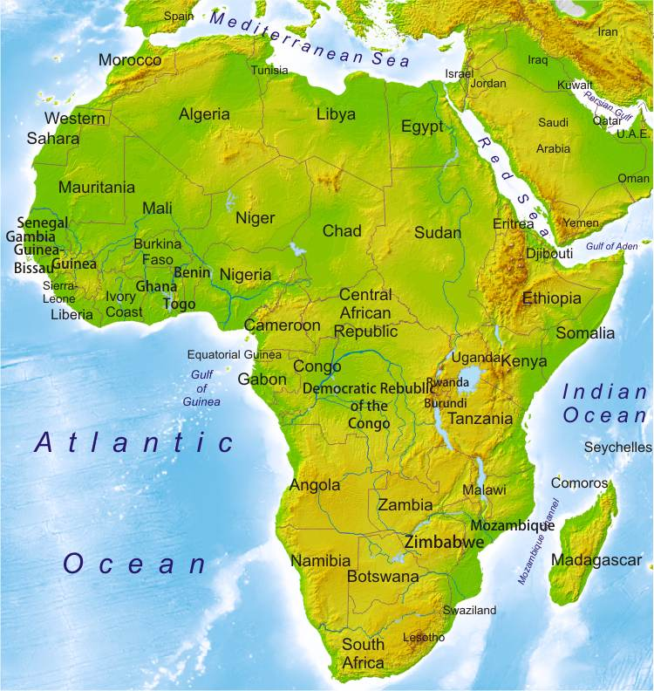
The Physical
Political
World
Mediterranean Sea
West Africa
South Africa
Notes:
If you were a network architect, what routes would you follow to connect the country of South Africa to the global Internet?
http://www.zonu.com/maps-l-en.htmlhttp://www.zonu.com/maps-l-en.html

Slide 6
Physical
Layer
Notes:
At the bottom of the abstractions are physical cables. Infrastructure changes nations. Africa has gained Internet bandwidth since 2010, to which some attribute the Arab Spring in which the governments of Tunisia and Egypt were overthrown. The thickness of the colored lines shows the bandwidth in undersea cables.

Slide 7

Physical
Layer
Plastic
Metal for Strength
Glass
Fiber
Notes:
The thick purple line on this map shows an undersea cable new in 2011, servicing western Africa. It cost South African investors $650 million (2012 USD). Data are carried only in the inner core of the cable, in four pairs of glass threads.

Slide 8
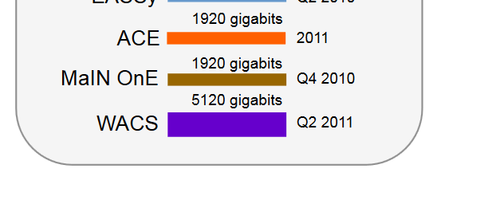
Physical
Layer
Notes:
Those tiny glass fibers carry zeros and ones: over 5 trillion bits per second. That’s 100,000 times faster than a typical U.S. home DSL service.

Slide 9
Infrastructure: What’s Your Priority?
Mediterranean
West Africa
South Africa
Notes:
But Internet connectivity is hardly the only infrastructure to think about. What percent of your budget do you want to devote to connectivity? As we climb the ladder of abstraction, keep in mind that high level decisions affect people’s lives. Decisions about infrastructure and the protocols that climb the ladder of abstraction are compromises among competing objectives.
http://www.zonu.com/maps-l-en.htmlhttp://www.zonu.com/maps-l-en.html

